Slide 1
THE MOON- CLIL PROJECT
a.s. 2022-2023
SCUOLA PRIMARIA DI TALLA
Discipline coinvolte Scienze –Tecnologia-
Destinatari :15 Alunni della classe quinta
Obiettivi : -Osservare, analizzare e descrivere fenomeni naturali seguendo un approccio scientifico e selezionando campi di indagine e dati pertinenti.
-Ricostruire e interpretare le fasi lunari
- Riconsocere le principali caratteristiche della luna e l’influenza sulla Terra (maree)
Argomenti :Moon facts . Moon phases – Moon eclipse- Tides.
Tempistica : 4 -5 lezioni
Valutazione : orale/ autovalutazione scritta
Insegnante:Laura Piccolo

Slide 2
Prodotti e risultati attesi: Conoscenza e potenziamento della lingua inglese Acquisizione e potenziamento delle capacità cognitive necessarie per l’apprendimento in lingua inglese.
Acquisizione del lessico specifico di materia in lingua inglese Acquisizione e miglioramento delle capacità comunicative .

Slide 3
4 C - CLIL
CONTENT | COGNITION | CULTURE | COMMUNICATION
I will teach: The moon Facts about moon Moon phases Moon eclipse tides Language aims :-Present simple . There is/ there are Demonstratives . Ordinal numbers - Adjectives :low- hight, full, new -Days of the week: Sunday. Monday- Tuesday-Wednesday-Thursday Friday Saturday Preposition of place :behind ,between, on, in front of . Lessico ”To orbit” – Turn around bright ” to rotate”, ”rotation” transaltion . Craters,Earth Moon. Star. Sun. Tides. | - Understanding the relationship between the moon and the Earth . Understanding different features of moon phases Appling Knowledge about moon Knowing how to organize the information regarding moon - Recognize lunar phases Remembering the names of moon phases . Draw the moon phases- Recognize lunar eclipse Knowing how to complete a on line game on the information learned from the lessons - Knowing how to complete the phrases concerning the proposed text. Remember scientific words | Using the interactive board. Describing natural and scientific topics | - Discuss and play in group/pairs. Understand a text and represent it. - Produce and describe an image inserted in a well predetermined context. Analyzing relationships- Improve language skills. Drawing and Writing moon phases Writing the date and the days of the week making a full moon calendar

Slide 4
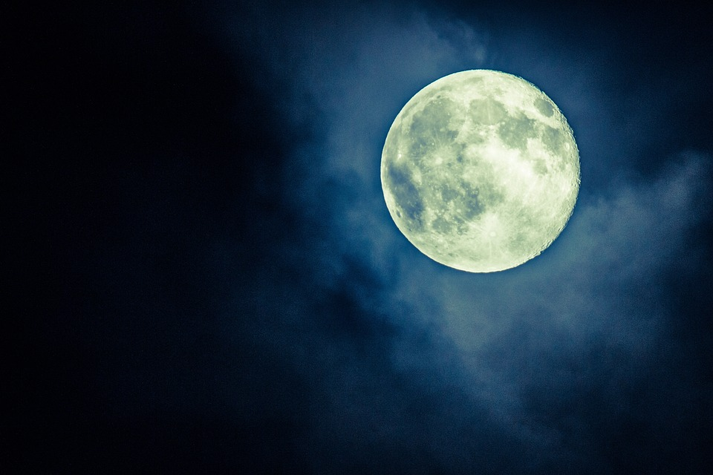
MOON facts
Lesson 1 Topic:
The Moon is natural satellite.
It orbits around the Earth.
The Moon moves in two ways:
TRASLATION
ROTATION
3. It takes the Moon 28 days to complete both:its journey around the Earth,and its rotation around its axis.
4. The Moon is 4 times smaller than the Earth.
The distance between the Moon and the Earth is about 385.000 km. The moon reflects sunlight. Moon is all rocks and craters.
Notes:
4

Slide 5
5. We don't always see the same shape of the Moon: there are 8 lunar phases. They repeat every 28 days.
Lesson 2 topic: moon phases
What Are the Moon’s Phases?
The Short Answer:
We have a slightly different view of the Moon each night. We describe how the Moon looks with the eight Moon phases, or shapes: 🌑 New
🌒 Waxing Crescent
🌓 First Quarter
🌔 Waxing Gibbous
🌕 Full
🌖 Waning Gibbous
🌗 Third Quarter
🌘 Waning Crescent

Slide 6
Flashcards and glossary

Slide 9
The Moon’s appearance changes throughout the month. Credit: NASA's Scientific Visualization Studio

Slide 10
Songs about moon
https://youtu.be/vt_LtIJyISQ
https://youtu.be/fFMtm2TakRQ

Slide 11
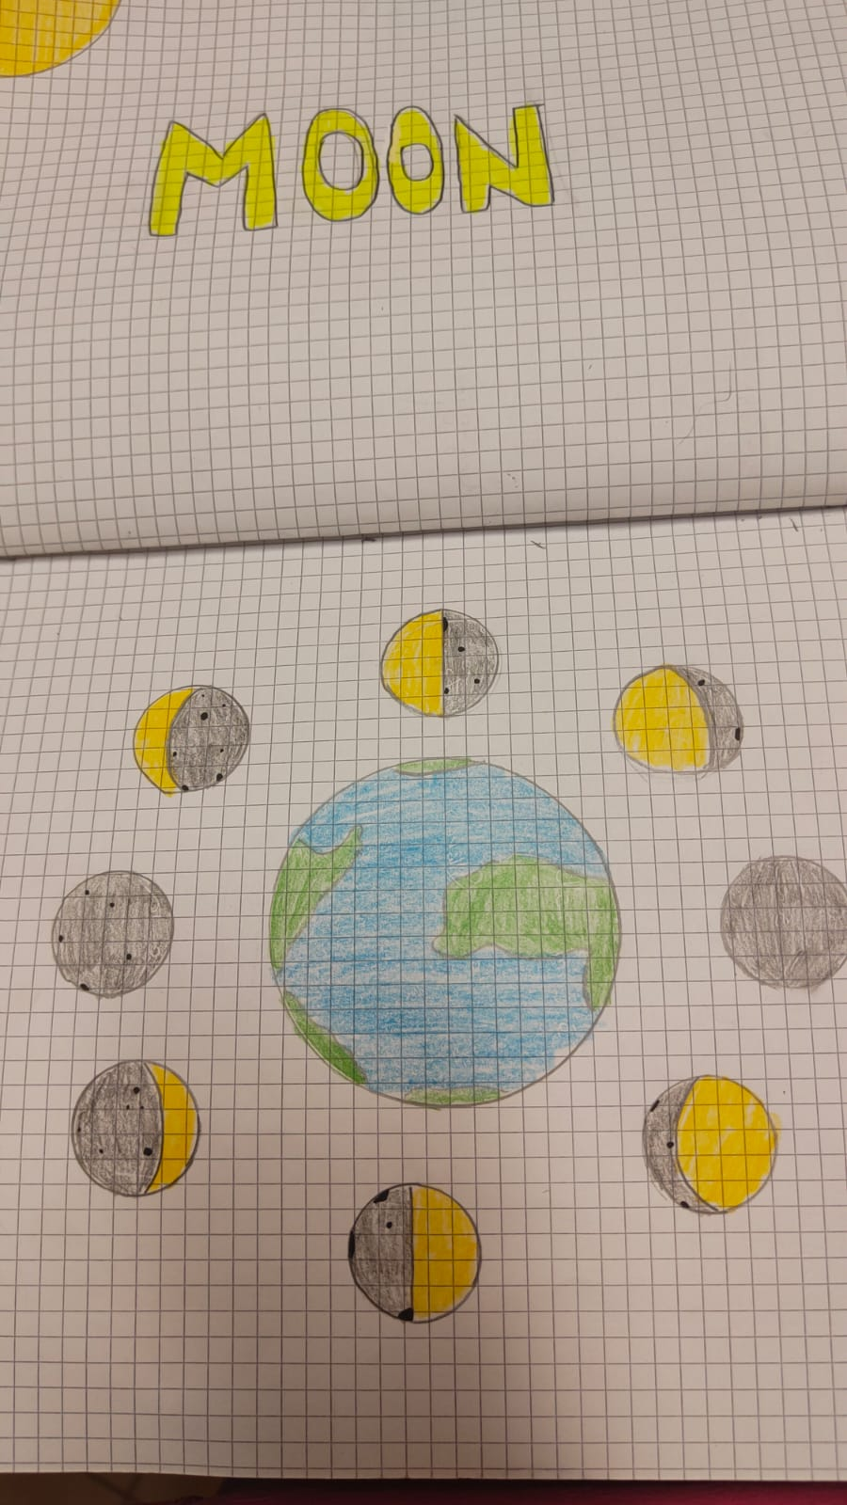
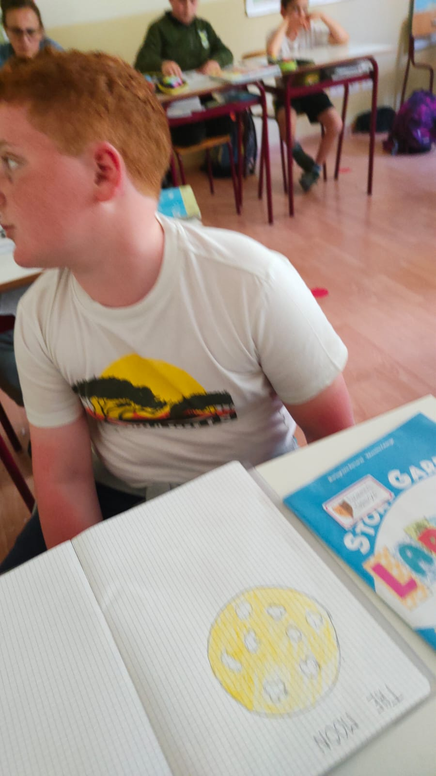
PAIRS WORK ACTIVITY
D
R
A
W
I
N
G
AND
S
P
E
A
K
I
N
G

Slide 12
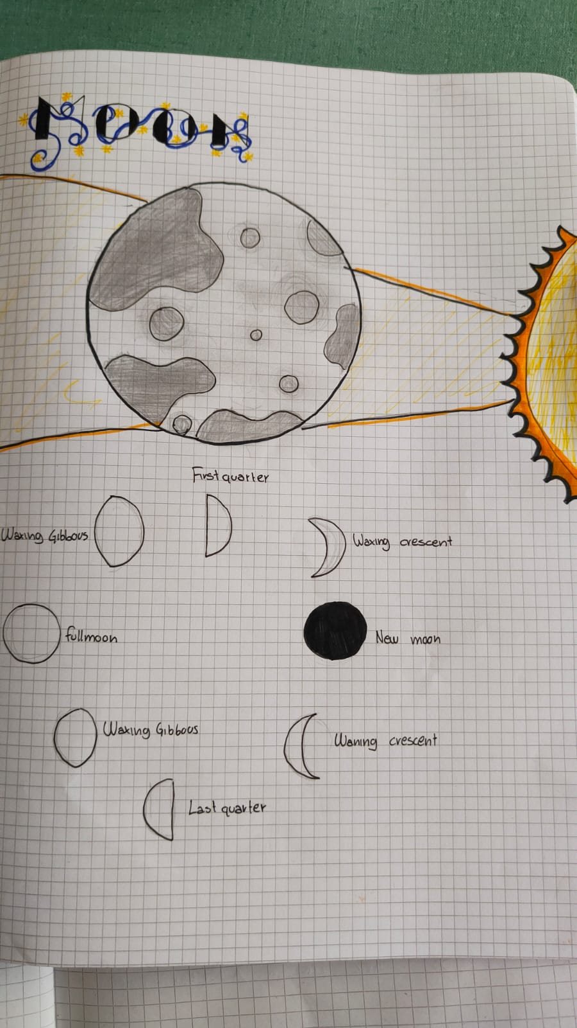
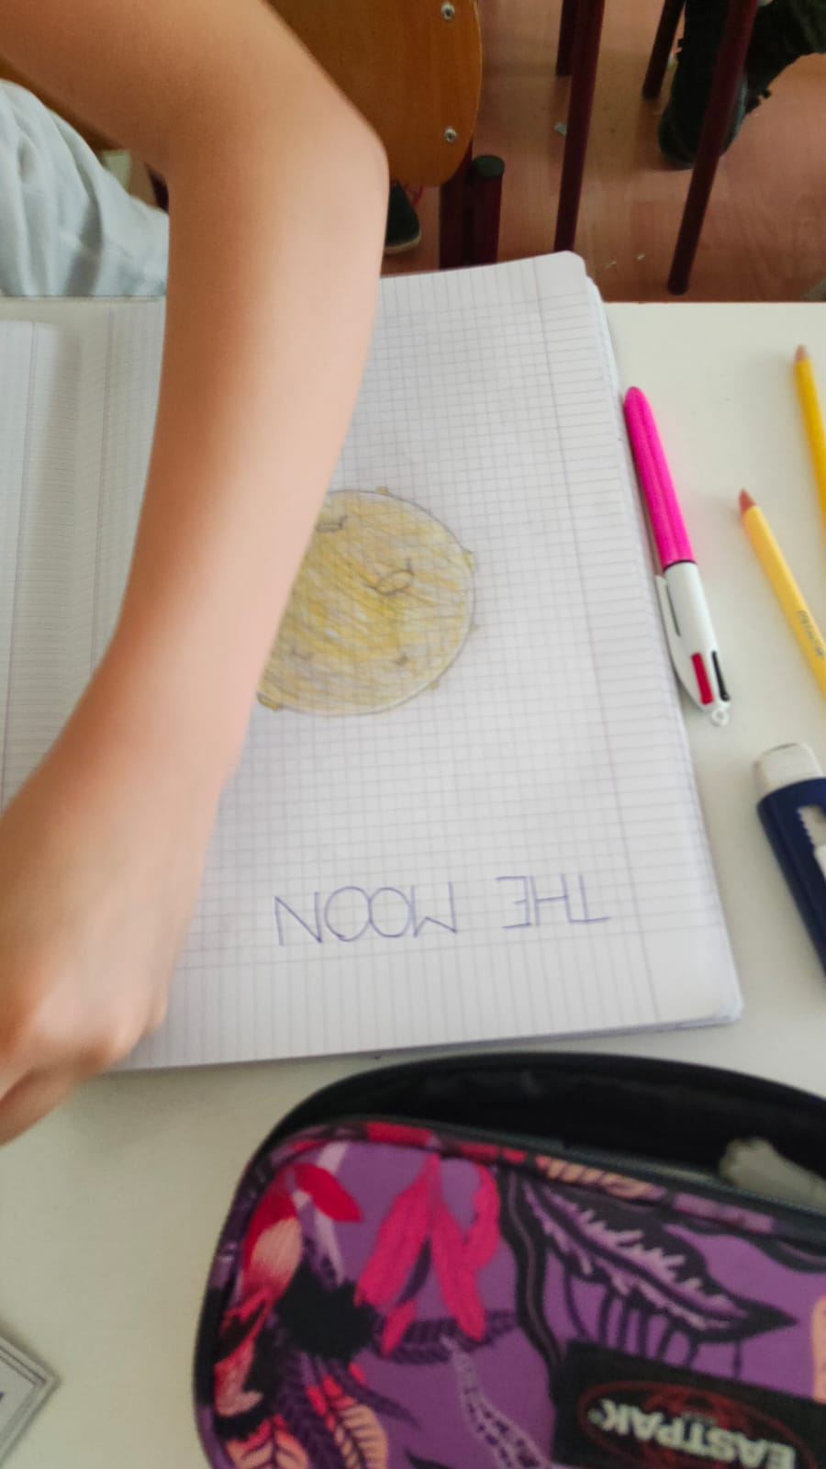

Slide 13
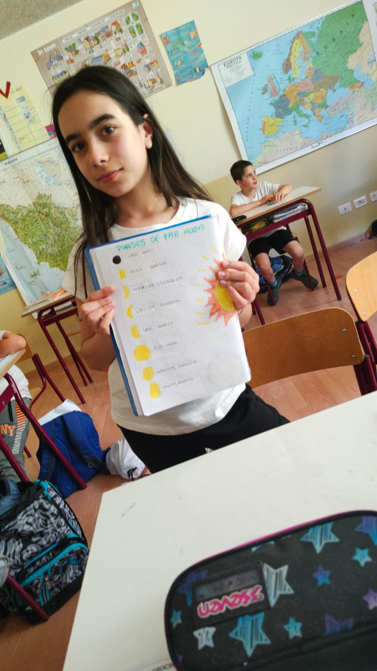
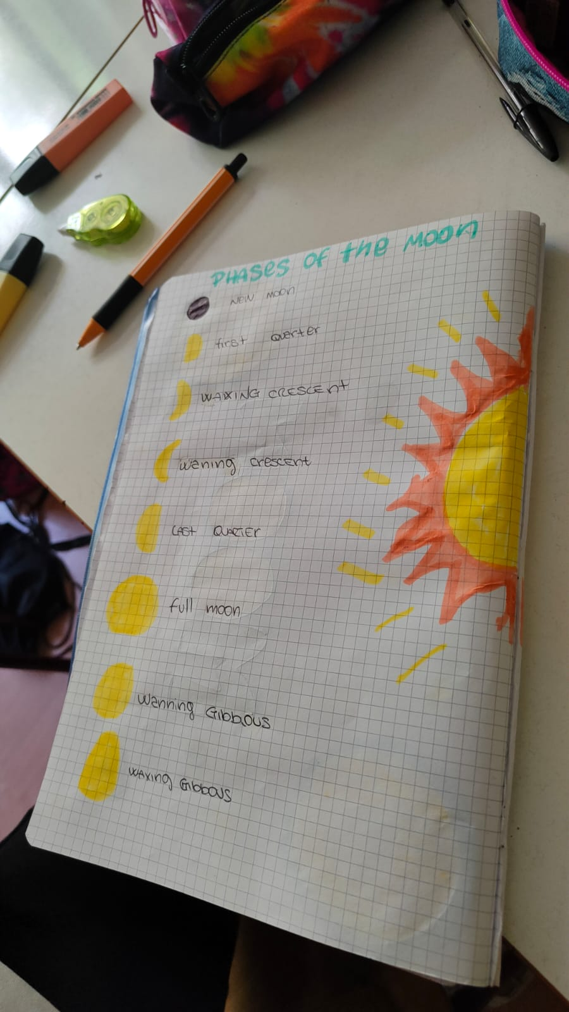

Slide 14
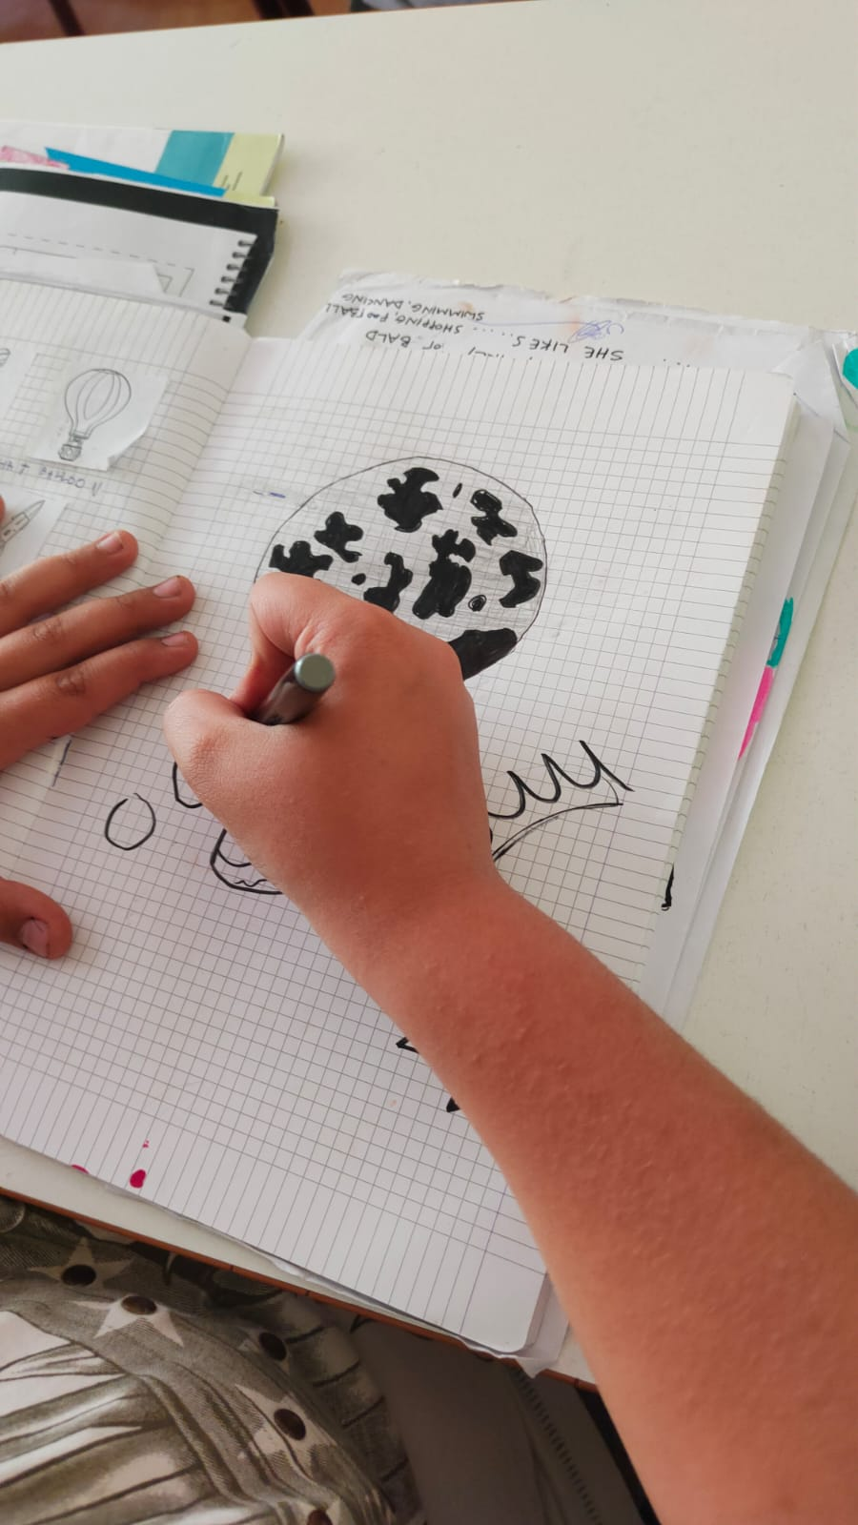
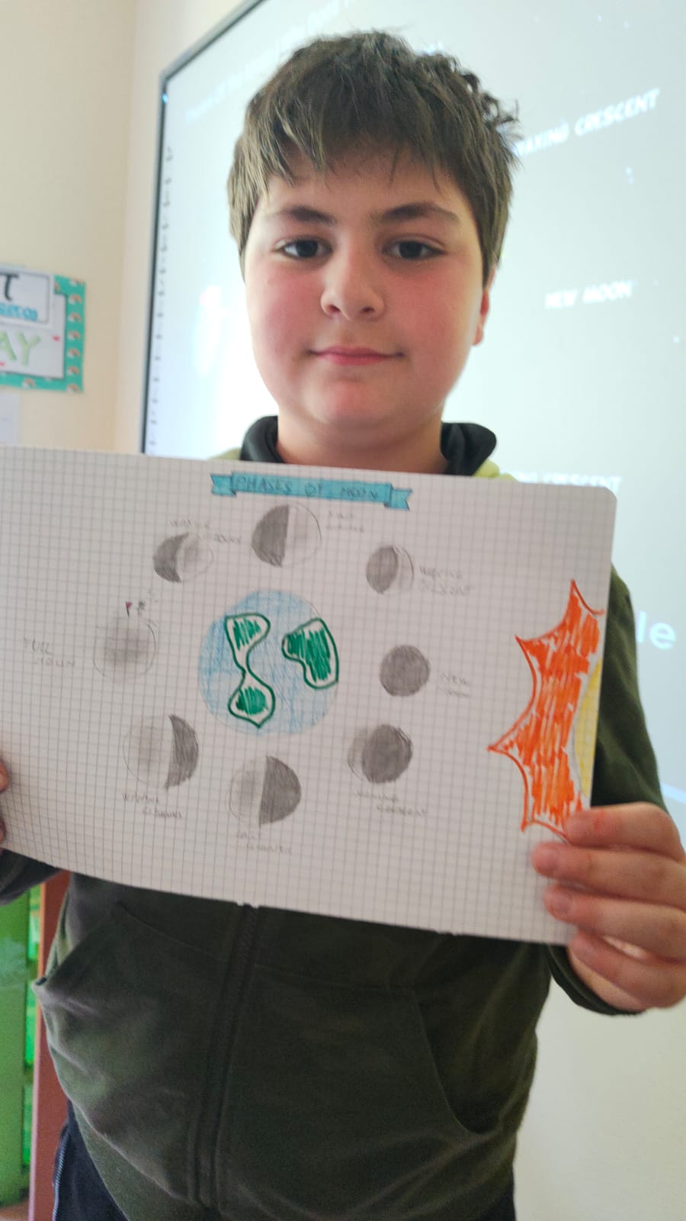

Slide 15
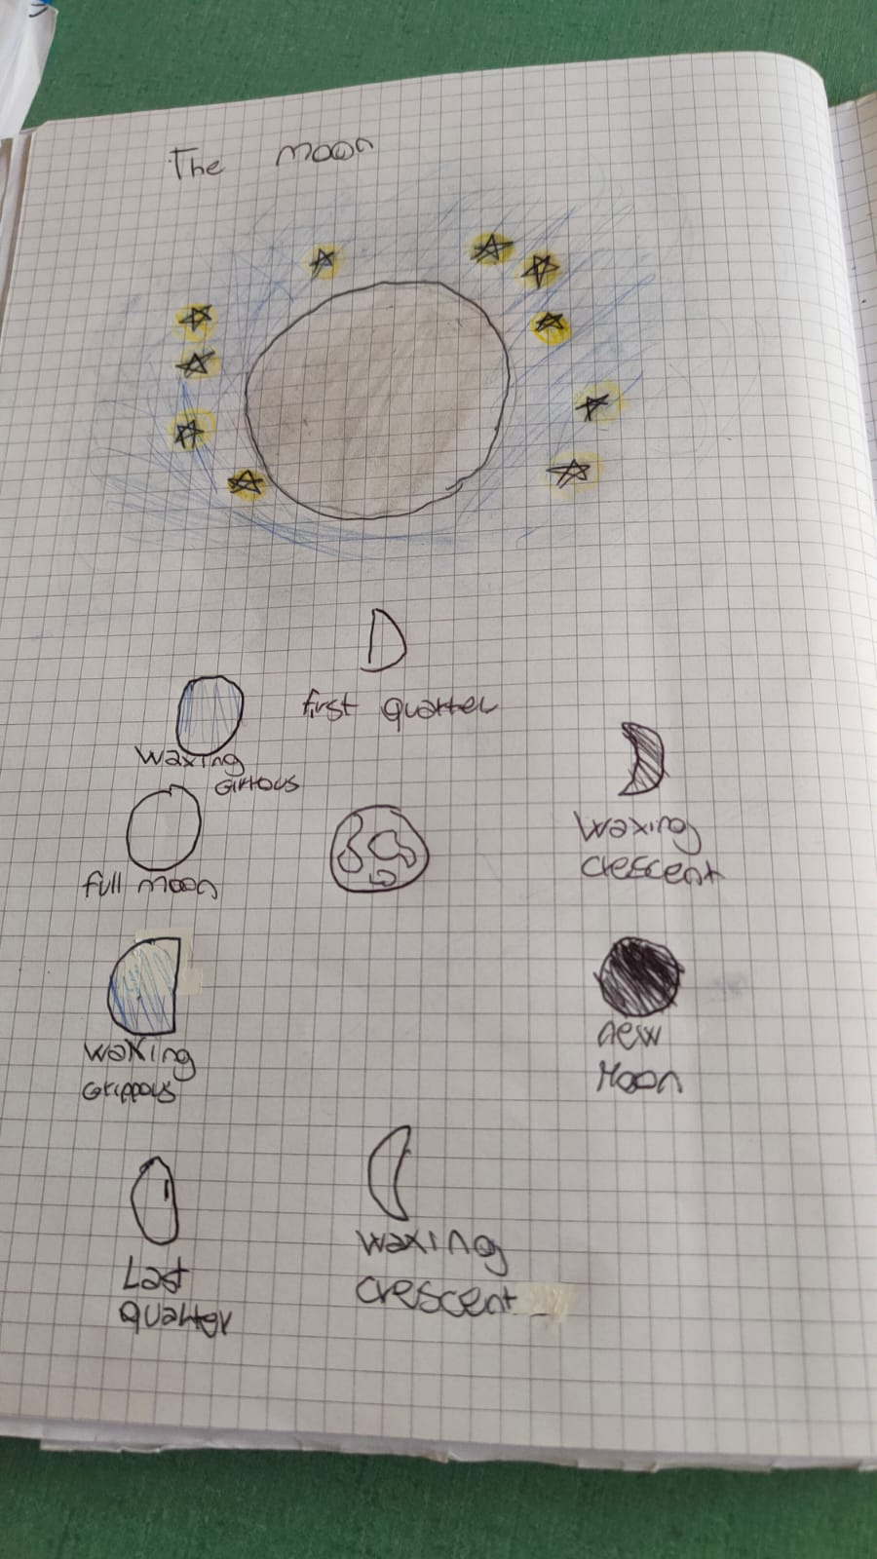
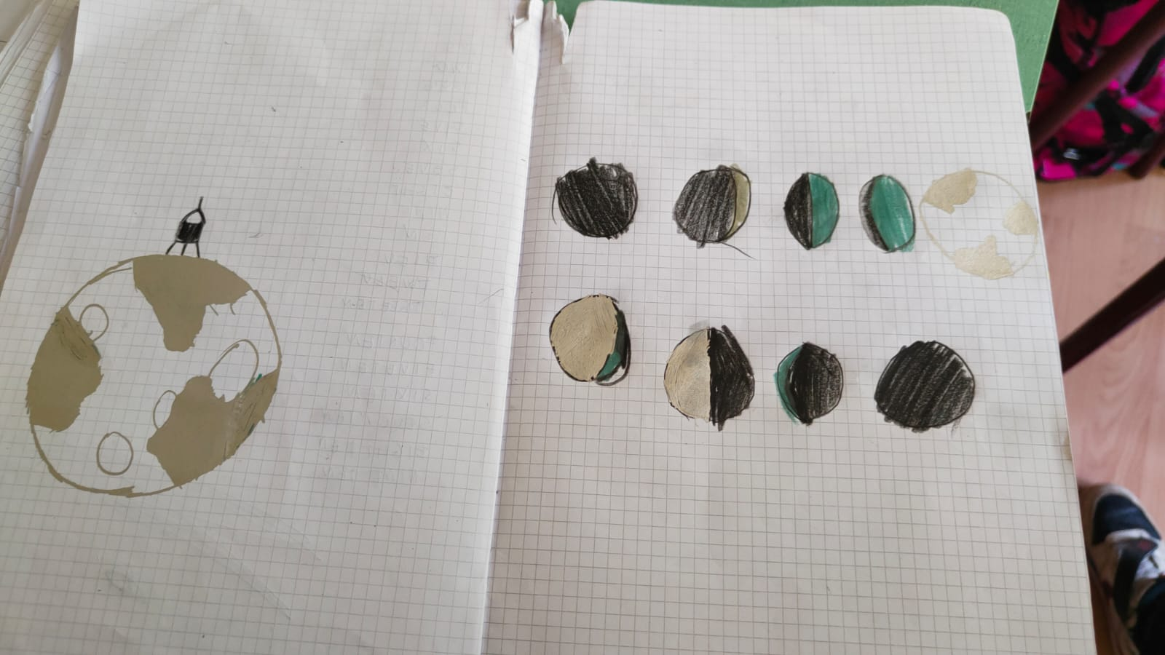
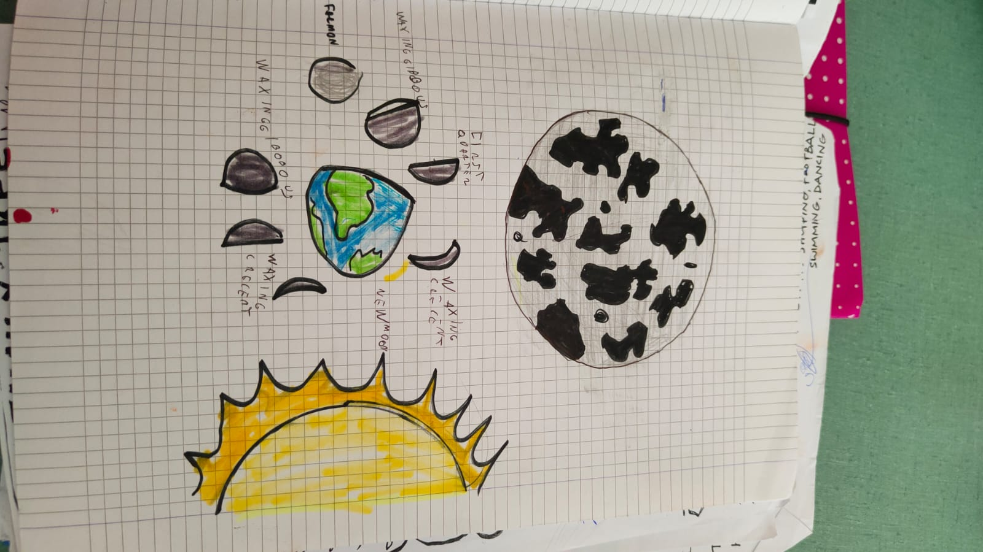

Slide 16
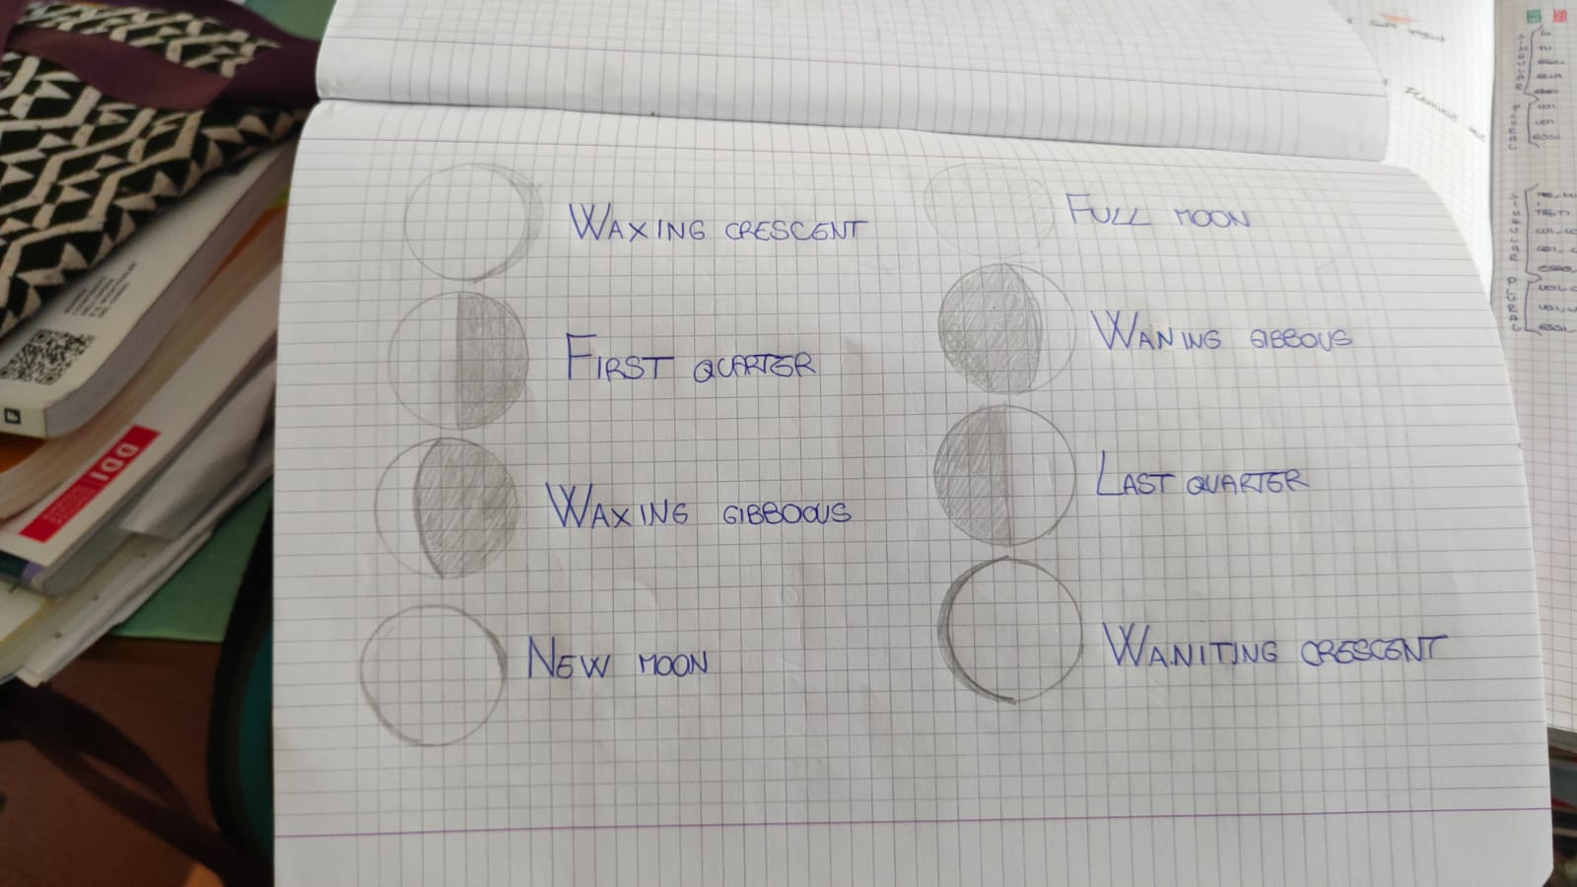

Slide 17
Games on line :
https://wordwall.net/resource/11655739/science/moon-phases

Slide 18
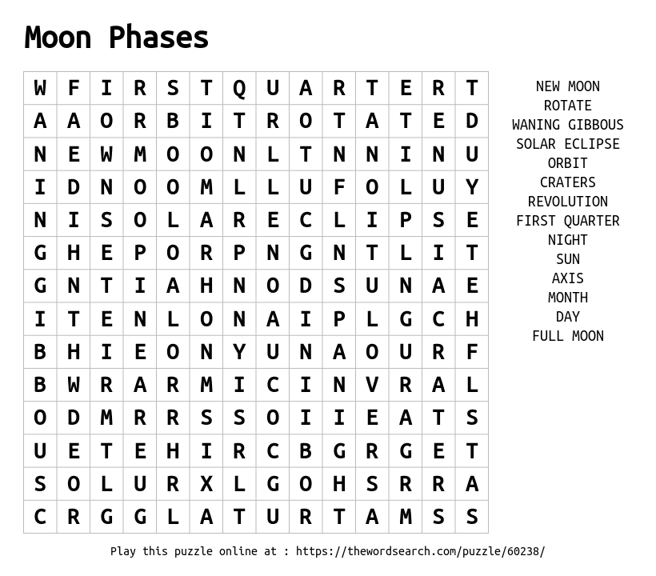
://spaceplace.nasa.gov/full-moons/en/

Slide 19
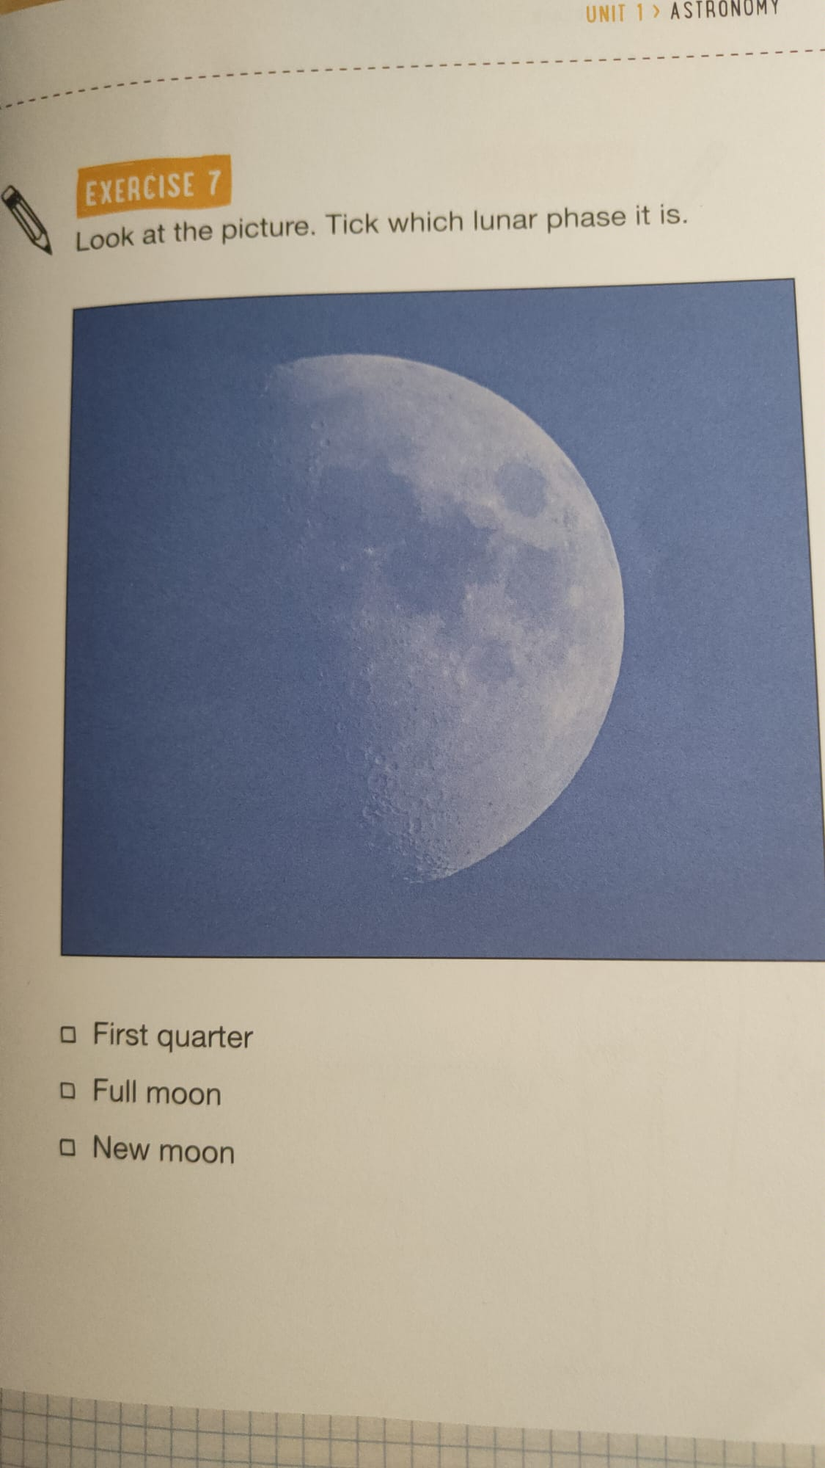
Verifica lesson 2

Slide 20
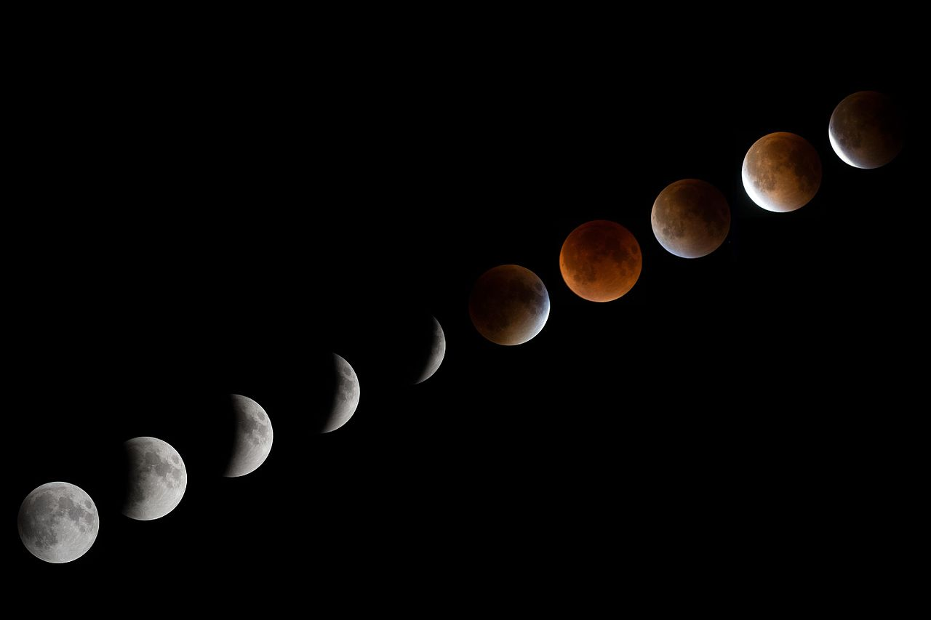
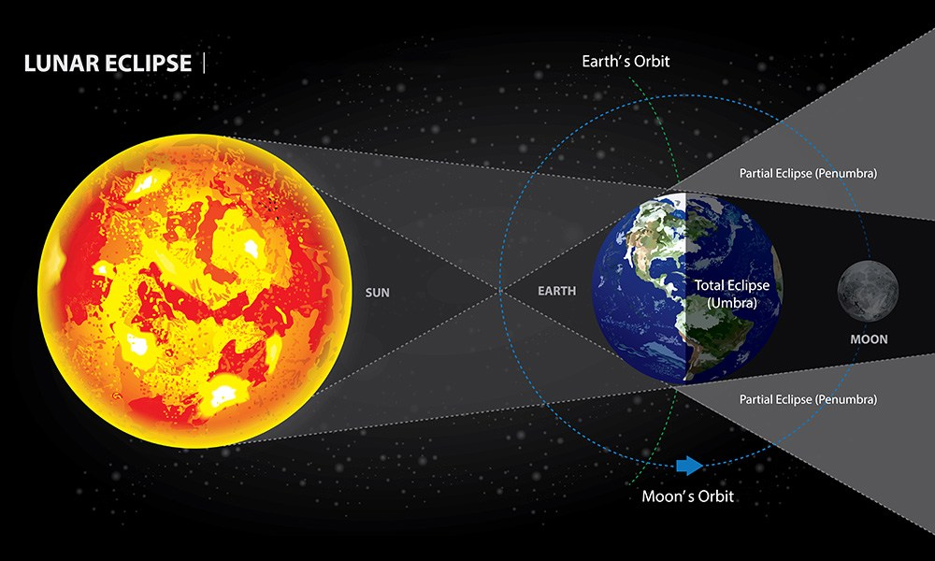
Lesson
Lesson 3 topic:Lunar eclipse
A lunar eclipse happens when the Moon passes directly behind the Earth into its umbra (shadow). The Earth fully or partially blocks out the sunlight from reaching the moon.
Questa foto di Autore sconosciuto è concesso in licenza da CC BY

Slide 21
Video about lunar eclipse

Slide 22
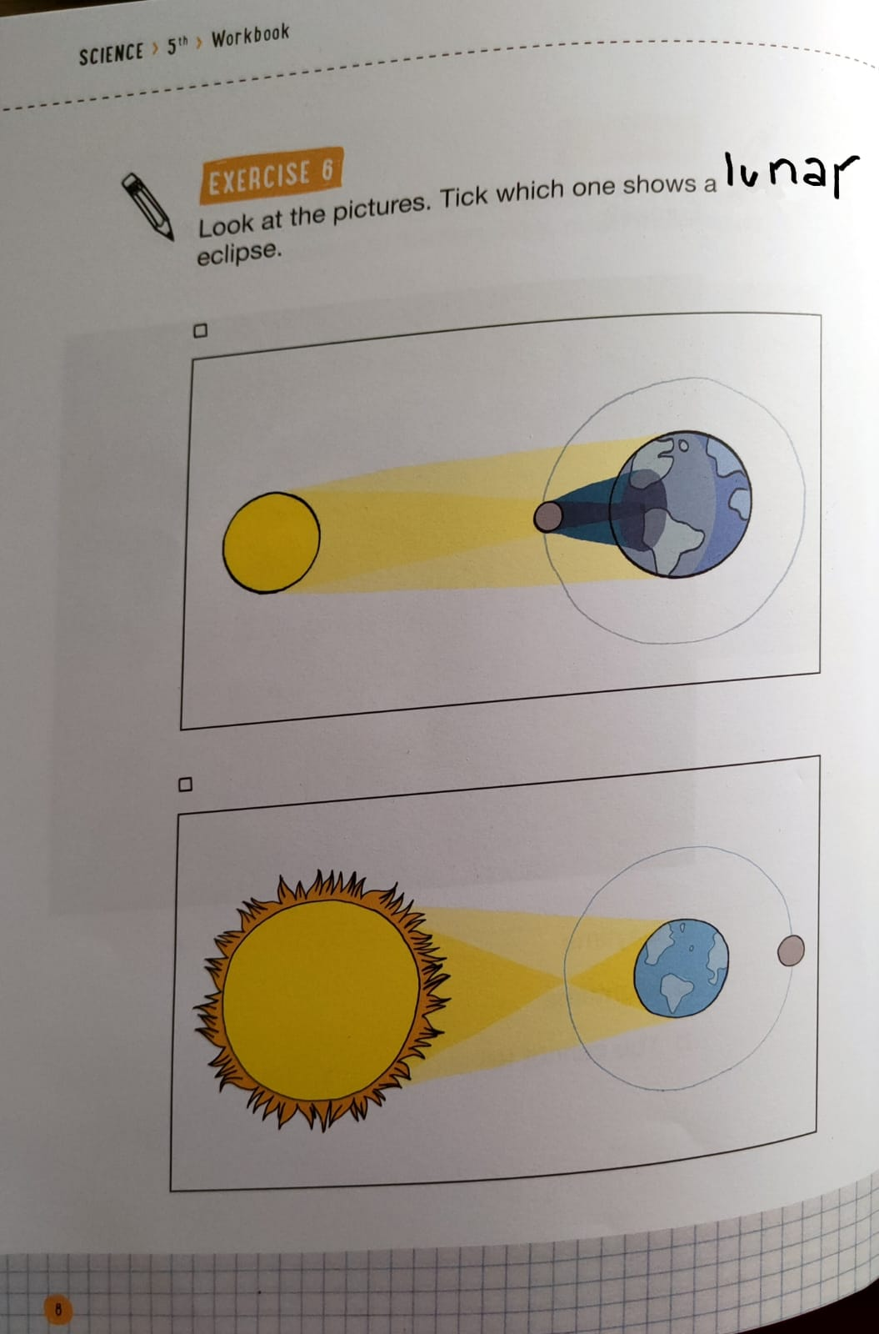
Verifica lesson 3

Slide 23
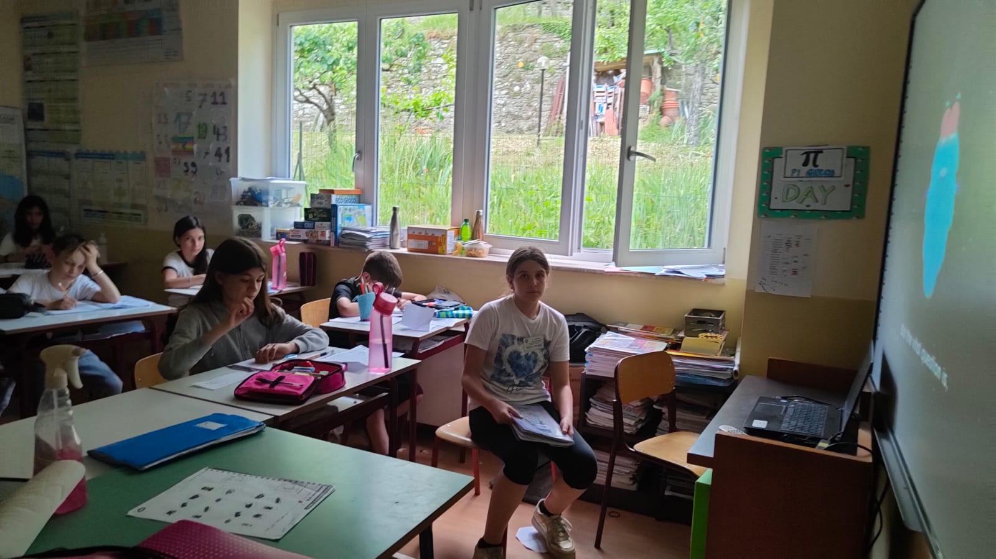

Slide 24
lesson 4 Topic TIDES
The Moon generates tides.
The tide is a rise and fall of
the Sea Level.They occur every six hours approximately.
Notes:
24

Slide 25
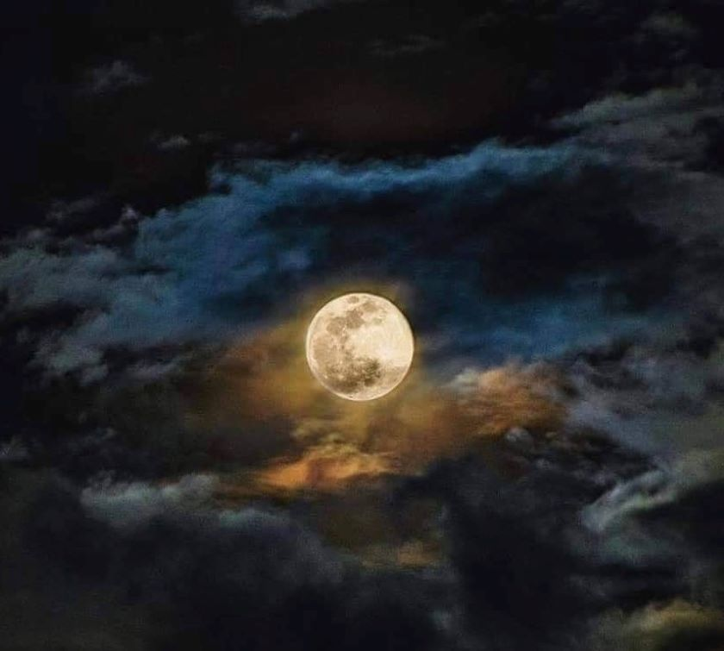
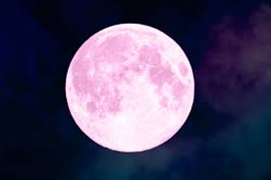
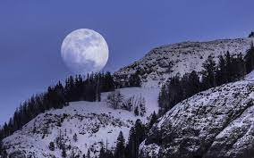
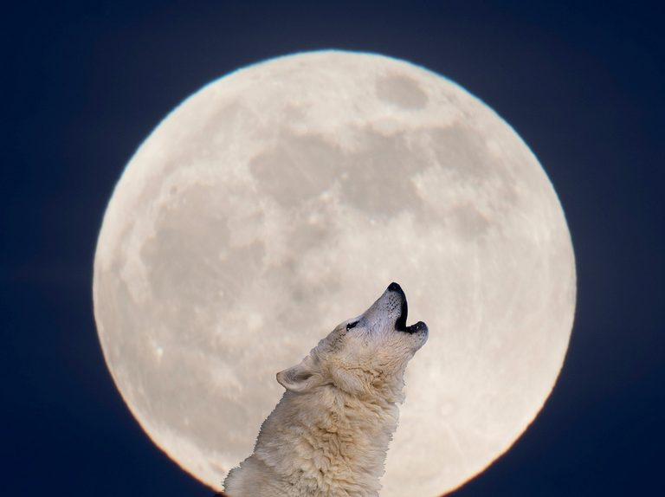
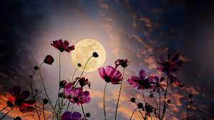
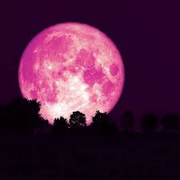
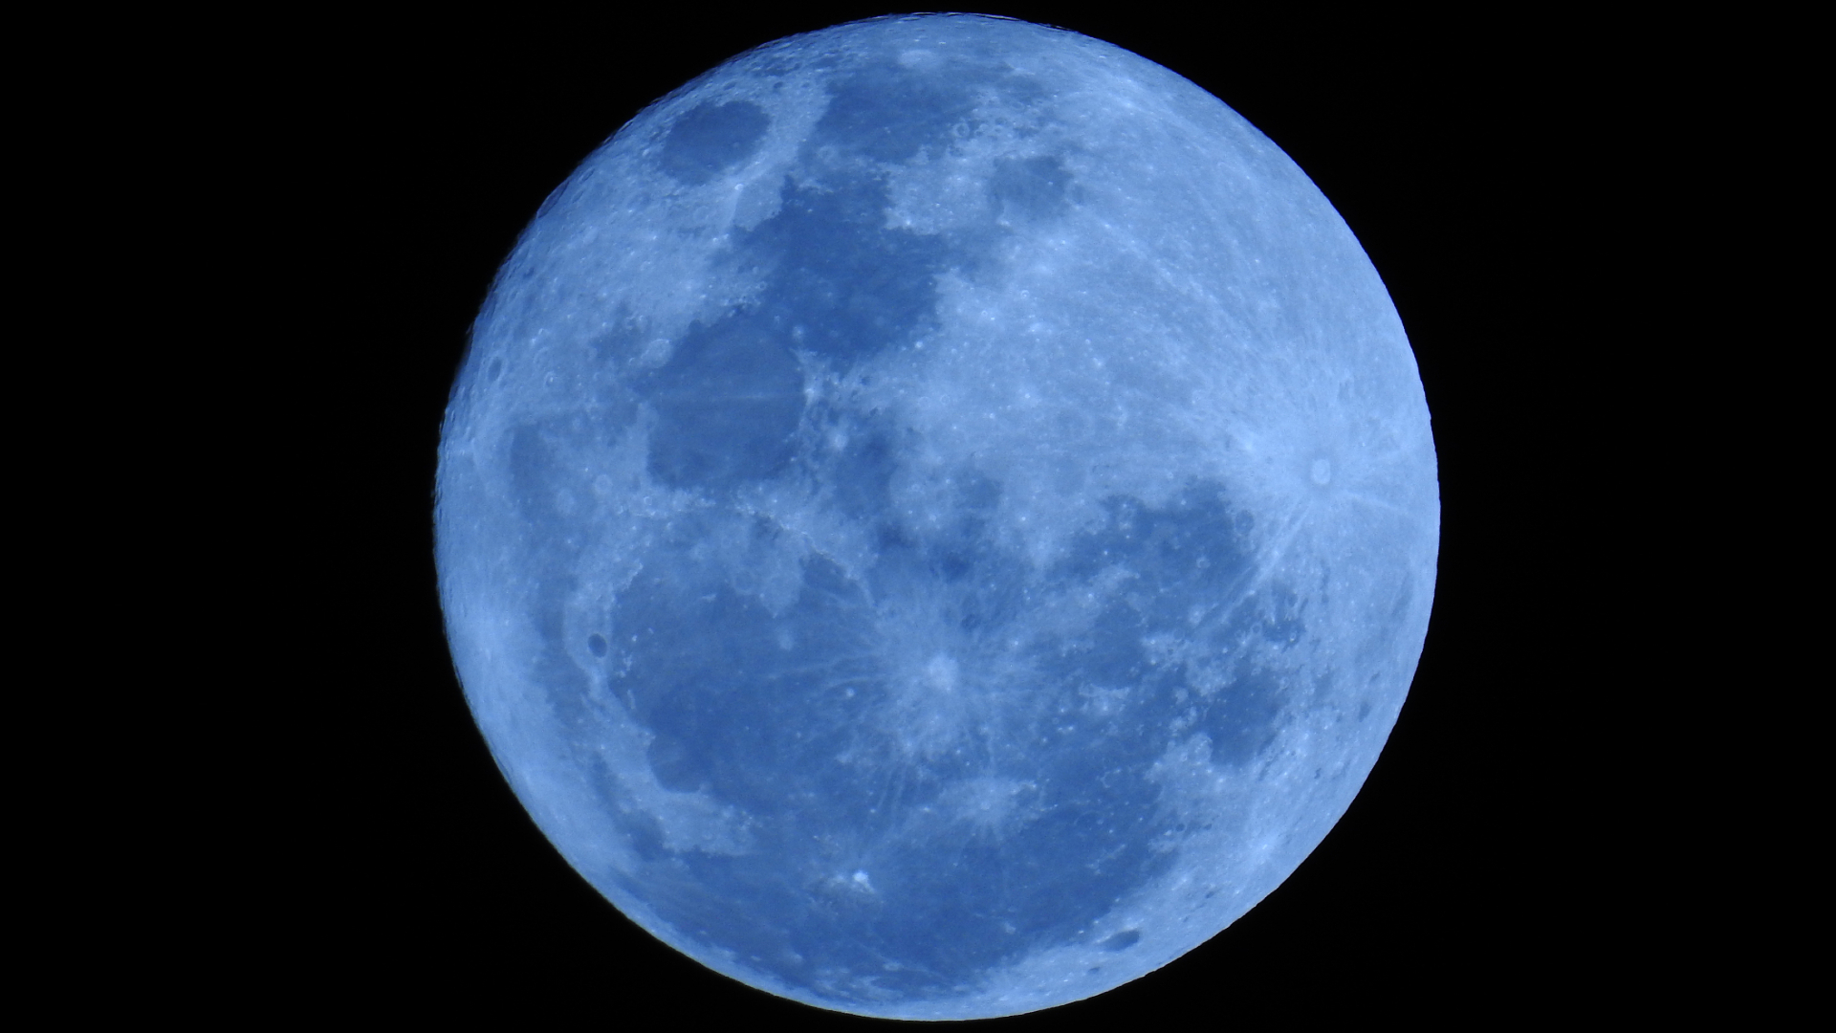
Snow Moon
Wolf Moon
FULL MOON CALENDAR 2023
WHEN IS NEXT FULL MOON? What are the names of 2023 full moons?
Pink Moon
Full Moon date and time | Full Moon name
6 January (11.07pm) | Wolf Moon
5 February (6.28pm) | Snow Moon
7 March (12.40pm) | Worm Moon
6 April (5.34am) | Pink Moon
5 May (6.34pm) | Flower Moon
4 June (4.41am) | Strawberry Moon
3 July (12.38pm) | Buck Moon
1 August (7.31pm) | Sturgeon Moon (supermoon)
31 August (2.35am) | Blue Moon (supermoon)
29 September (10.57am) | Corn/Harvest Moon
28 October (9.24pm) | Hunter's Moon
27 November (9.16am) | Beaver Moon
27 December (12.33am) | Cold Moon
Blue Moon (supermoon)

Slide 26
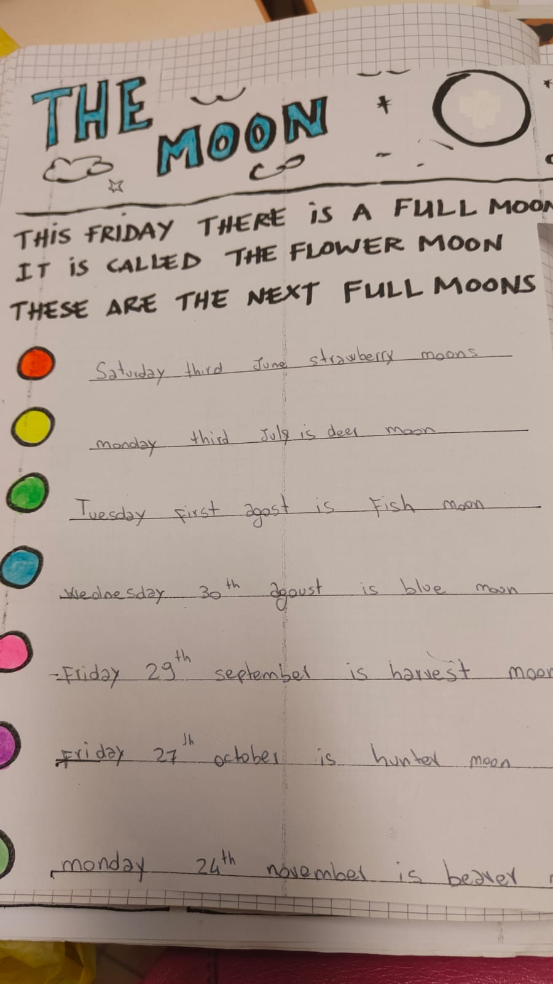

Slide 27
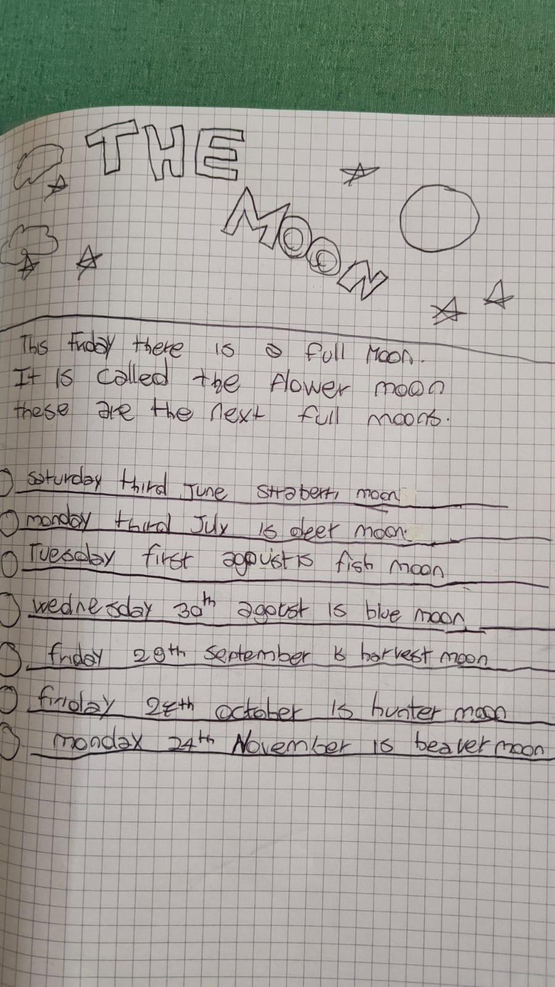

Slide 28
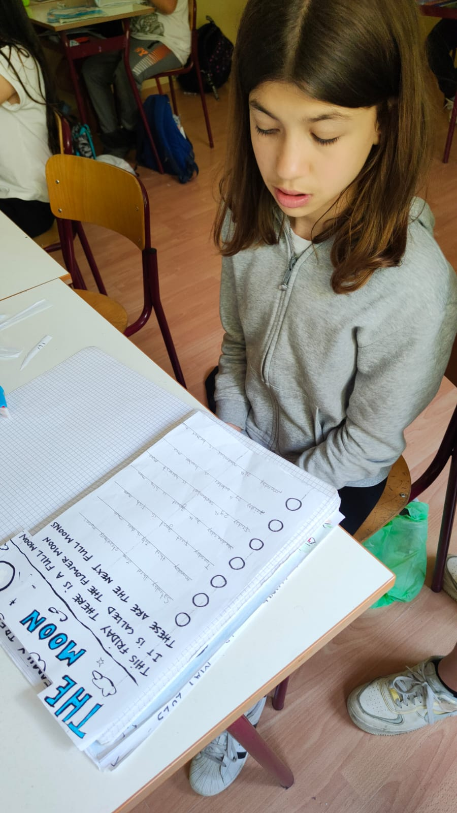
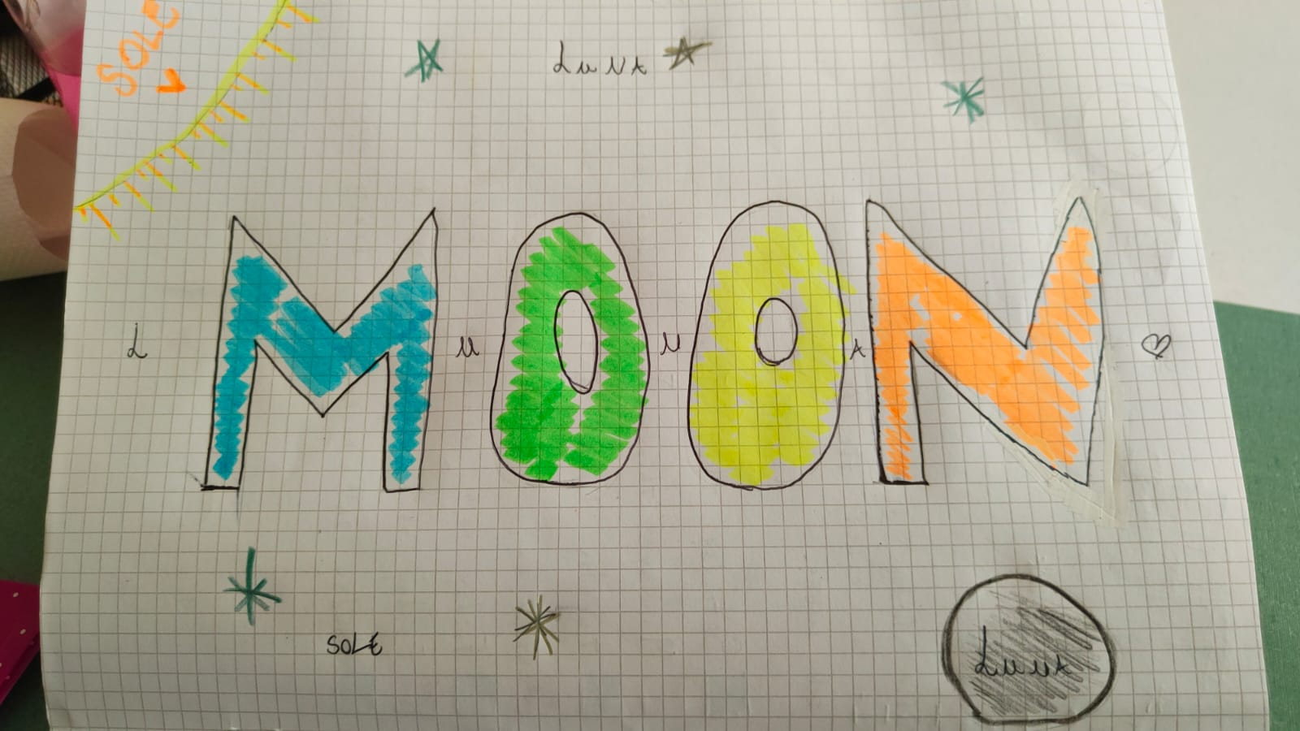
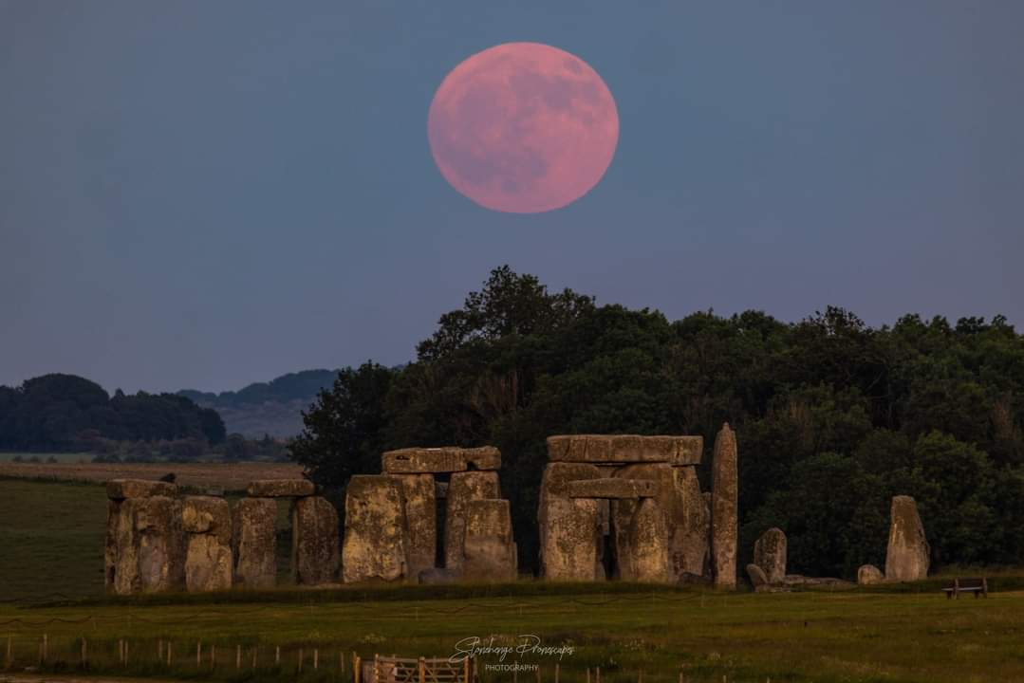

Slide 29
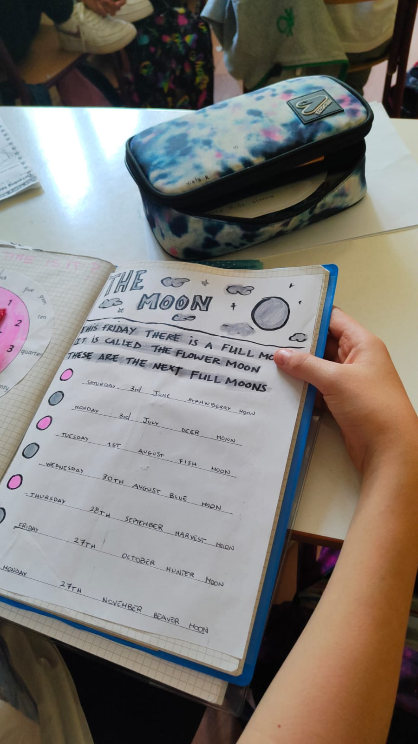

Slide 30
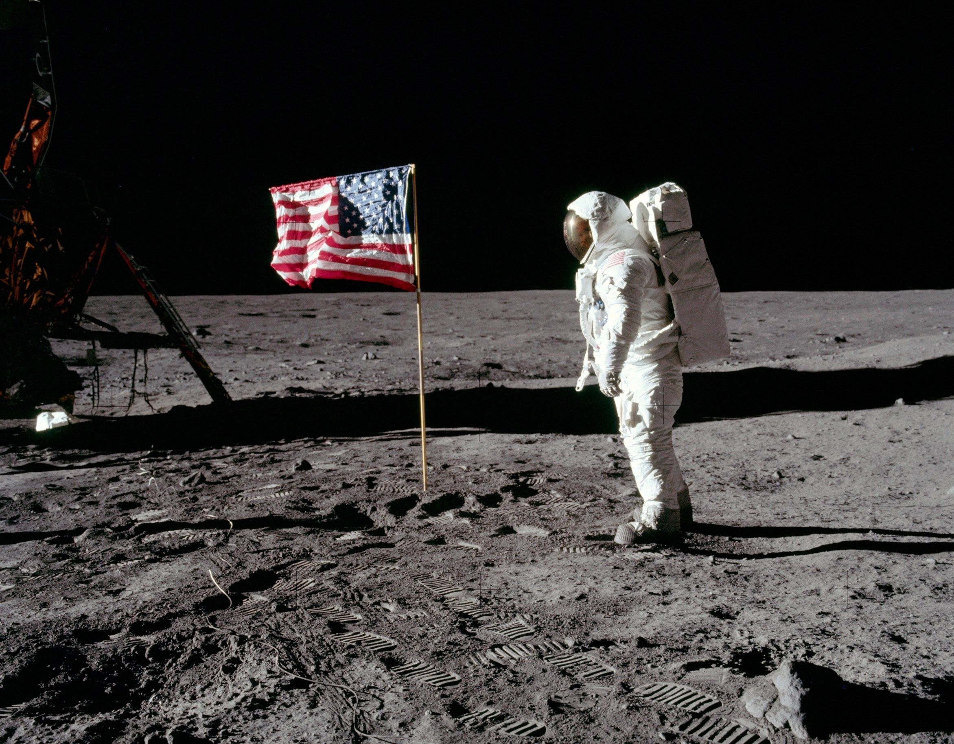
"One small step for a man, one giant leap for mankind”
Le parole che pronunciò Armstrong quando scese sul suolo lunare furono :questo è un piccolo passo per l'uomo, un grande passo per l'umanità.

